Slide 1
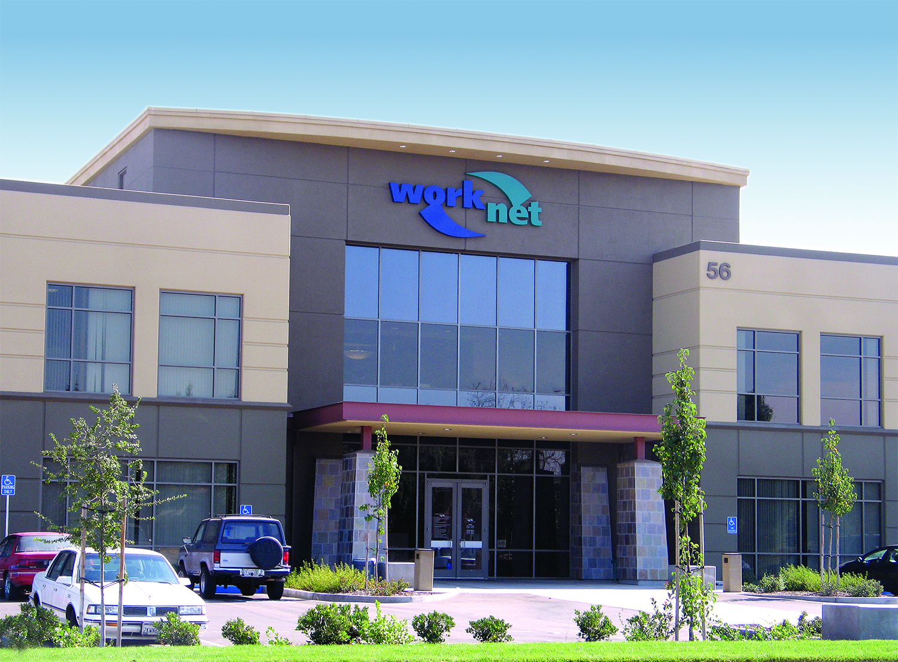



THE EMPLOYMENT & ECONOMIC DEVELOPMENT DEPARTMENT
CRITICAL & ESSENTIAL SERVICE ASSISTANCE
FOR EMPLOYERS AND SMALL BUSINESSES
DURING THE COVID-19 CRISIS
1

Slide 2
Unemployment Insurance (UI) Claims State EDD Publishing UI Claims Data Each Thursday for the prior week
UI CLAIMS PROCESSED
DATE PROCESSED | No. of Claims
Week ending March 7, 2020 | 48,385
Week ending March 14, 2020 | 57,606
Week ending March 21, 2020 | 186,809
Week ending March 28, 2020 | 878,727
WEEK ENDING APRIL 4, 2020 | 925,450
2

Slide 3

2020 Unemployment Rate Comparisons Under Coronavirus (COVID-19) Pandemic Crisis
EDD Website: https://www.edd.ca.gov/newsroom.htm
According to the EDD Labor Market Consultant, the updated Unemployment Rate information will become available Friday, April 17, 2020
3

Slide 4
Unemployment Insurance Benefit Package Under the COVID-19 Stimulus
Additional benefits of $600.00 per week
Through July 31, 2020
No more than 39 weeks
4

Slide 5
Unemployment Insurance Claims UI Complaints
Numerous complaints about the status of their U.I. checks
Residents are calling and not getting a response
No one is answering the telephone
Disqualifying eligible claims and not being given any reason
What can they do to re-apply if eligible?
Corrective Actions:
Hired Retirees Intermittent Staff
Pull Staff from Job Centers LMID and Other Divisions
Trained all Staff on New Requirements
Made more Staff Available to Answer Telephones from 8:00 a.m. – 5:00 p.m.
5

Slide 6
Weekly Local Workforce Development Directors Meetings with State Partnership
Weekly Meeting on Thursdays from Noon-2:00 PM
National Emergency Grants
Focus on National Stimulus Packages
Discuss Complaints and Critical Issues
Forwarding Complaints to administration
6

Slide 7
Rapid Response Team Activities
As of March 19, 2020
EEDD received 36 Worker Adjustment and
Retraining Notification (WARN) Act Notices
Displacing a total of 2,760
Initiating contact with each employer
Releasing information packet with instructions
Scheduling interviews with displaced workers
Orientation provided on-line certification and enrolled process
Employers are getting a special packet containing pertinent information on the available resources
7

Slide 8
Companies Currently Hiring in San Joaquin County
These are just a few of the companies hiring in San Joaquin County during COVID-19 crisis
Company | Location | Approximate Amount Available
Amazon | All Locations | Continuous/500+
Great Wolf Lodge | Manteca | 500+
Costco Distribution | Tracy | 50+
Safeway | All Locations | Continuous/400+
Walmart | All Locations | Continuous
C&S Wholesale/Tracy Logistics | Stockton | 100+
Blue Line Distribution | Stockton | 10+
Simwon USA | Lathrop | 50+
Xcel Logistics (FedEx) | Tracy | 40+
Apria Healthcare | Stockton | 100
JM Eagle | Stockton | 20
Big Lots! | All Locations | 50-75
1845
Jobs Available
8

Slide 9
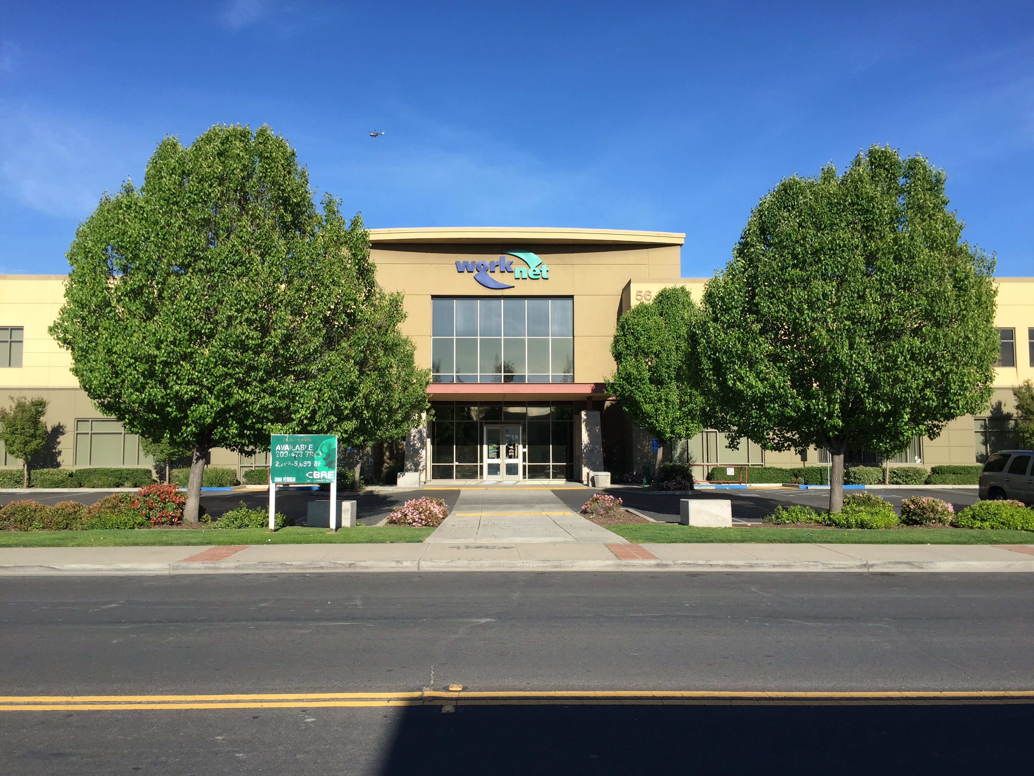
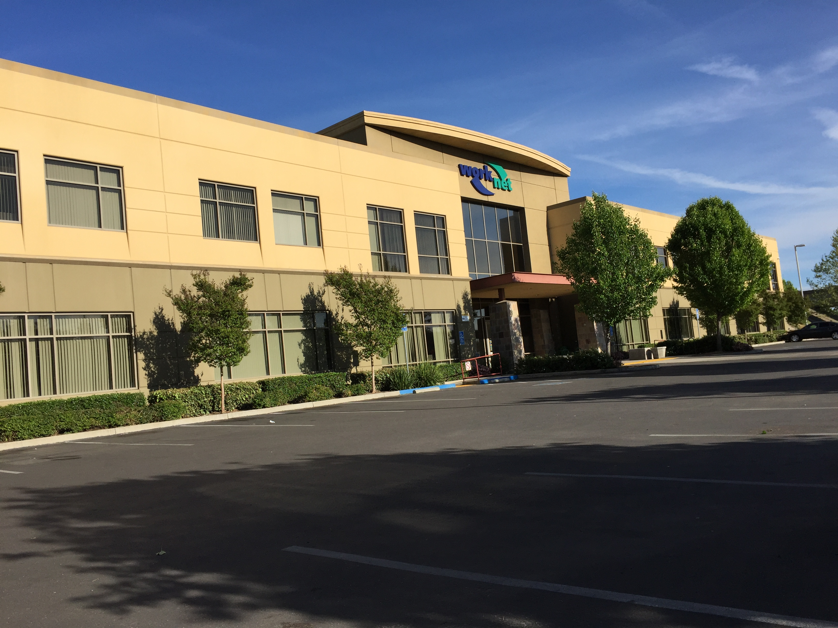
San Joaquin County WorkNet Centers
Delivery Essential Services:
By Appointment Only
Tele-Conferencing, Text Messenger, and Telephone Communication
On-Line Services Available through our website www.sjcworknet.org
WebEx – Interviews and Orientations
Following an Interview – Customers Receive an Orientation Packet to Initiate the Intake and Certification Process
9

Slide 10

San Joaquin County WorkNet Center Protocol Delivery of Essential Services
Supporting Active and Enrolled Customers
Initiating the Intake and Certification
Delivering Employment and Training Services
Eliminate Barriers to Employment and Training
Facilitate the Transition to Employment
10

Slide 11
San Joaquin County WorkNet Center Partner Collaboration & Coordination Activities
Coordination and Collaboration taking place
Scheduled WebEx Meeting
Telephone Communication
Established Protocols Followed
Text Messaging
On-Line Service Delivery
11

Slide 12
San Joaquin County WorkNet Center Delivering Business Service
Providing qualified Job Candidates to
meet Labor Demands
Filling Job Orders
Direct Placement
On-The-Job Training Contract
Private Sector Work Experience Agreement
Scheduling Interviews via Telephone and WebEx
12

Slide 13

EDA’s Economic Development Center Working With Businesses And Helping Them Access Available Resources
Collaboration is High w/Partner Agencies
Economic Development Association
Small Business Development Center
Chambers of Commerce
San Joaquin Partnership
Small Business Administration
Municipalities
Working together sharing information and delivering
essential services to our Businesses under crisis
13

Slide 14
Small Business Administration Stimulus Package Disaster Loans
SBA Economic Injury Disaster
Advance of up to $10,000 Economic Stress due to Temporary Loss of Revenue
Loan Advance will not have to be paid
SBA Paycheck Protection Program
Include for Small Businesses to keep their Workers on Payroll
SBA will forgive loans if all employers are kept
SBA Debt Relief
14

Slide 15
Small Business Development Center (SBDC)
Provides Assistance to Small Business Owners and has a variety of resources to support Small Business Development.
Offers free and confidential business advice to Small Businesses
Assistance to Small Businesses Owners on the SBA Disaster Loans
SBA Economic Injury Disaster Loan
SBA Paycheck Protection Program Loan
Co-located at the Economic Development Center and the Comprehensive Lincoln WorkNet Center
15

Slide 16
Revolving Loan Fund Program Emergency Protocols Under the Pandemic Crisis
Modification of the RLF Administrative Plan to streamline the loan application process to support our Local Businesses under stress during this Pandemic Crisis.
Submitted to the Federal Economic Development Administration
RLF’s Emergency Business Support Fund
$600,000 Initial Capitalization
$75,000 Maximum Loan
Collaborating with Partner Agencies and Lending Agencies
Small Business Development Center
Small Business Administration
Municipalities
16

Slide 17

Economic Development Association Business Retention and Expansion Program
The EDA’s Business Retention and Expansion Program (BREP) Team is working with Local Businesses facilitating their access to needed resources.
Access to Partner agency Services
Accessing to the SBA’s Programs in the Stimulus Package
Assisting employers to navigate through the eligibility requirement and provide assistance in submitting their application
17

Slide 18
What is the difference between a Furlough and a Layoff?
A Furlough:
a temporary period in which an employer requires a worker to take unpaid time off work.
It is unpaid, but the employees are not separated from the employer and are able to continue to receive benefits i.e. health and retirement.
The employee is eligible to apply for unemployment during the time they are not paid.
18

Slide 19
What is the difference between a Furlough and a Layoff?
A Layoff:
a layoff essentially terminates the employment arrangement for the worker.
a layoff means that the employee is completely cut off from payroll and is no longer able to receive benefits through their employer but could be eligible for COBRA or Covered California.
The employee is eligible to apply for unemployment
19

Slide 20


Information Letters to Employers
Rapid Response Employers
Distressed Businesses
Small Businesses
These letters contain pertinent information about the services available through partner agencies containing instruction on how to access the services available and the agency that will provide assistance with an attachment containing contact information
20

Slide 21
COVID-19 Special & Competitive Grants
Grant Description | Target | Amount | Date
1. Workforce Accelerator Fund 8.0 | Homeless | $150,000 | 12/23/19
2. COVID-19 Disaster Recovery | NDWG | $487,500 | 3/27/20
3. COVID-19 Employment Recovery | NDWG | $450,000 | 3/27/20
4. Additional Assistance Grant COVID-19 Impacted | Displaced Worker | $303,000 | 4/03/20
5. STEPS WEX Students with Disabilities | Youth | $750,000 | 4/03/20
6. Employment & Training Services Grant | ELL | $350,000 | 4/01/20
7. Employment Training Panel — WDB | Incumbent Worker | $200,000 | 4/01/20
8. Employment Training Panel — EDA Mod | Incumbent Worker | $105,000 | 5/01/20
TOTAL COMPETITIVE GRANT POTENTIAL |  | $2,795,500
1

Slide 22
Thank You For Your Time!
Your Support is greatly appreciated
1

